Slide 1

Attention-Directing Composition of
Look Over Here:
Elements
Ying Cao
Rynson W.H. Lau
Antoni B. Chan
City University of Hong Kong

Slide 2
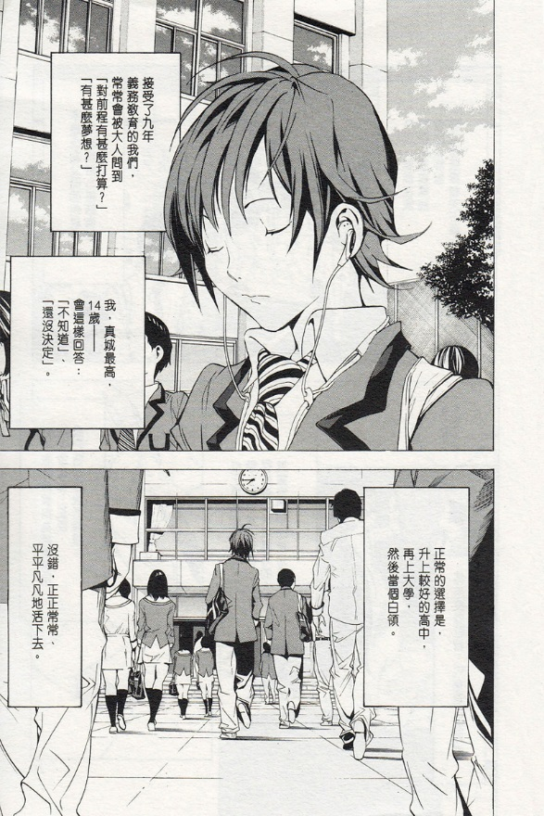
Composition of manga elements (i.e., subjects and balloons )
Motivation
© Tsugumi Ohba, Takeshi Obata / Shueisha Inc.

Slide 3
Motivation
Manga artist guides viewer’s eyes through the page
Artist’s Guiding Path
(AGP)
Viewer Attention
© Tsugumi Ohba, Takeshi Obata / Shueisha Inc.

Slide 4
Motivation
One of the most difficult steps in manga production
No existing comic creation programs for automatic composition

Slide 5

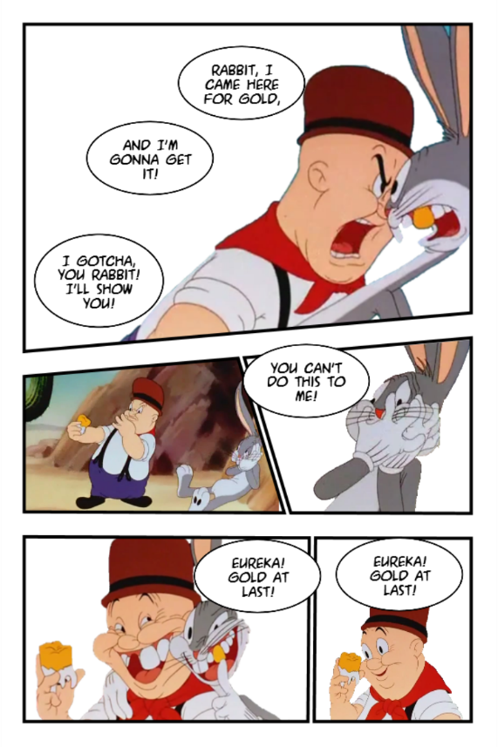



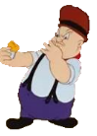


Goal
1
1.Rabbit, I came here for gold,
2. and I'm gonna get it!
3. I gotcha, you rabbit! I'll show you!
Close-up
Fast
2
Medium
Medium
You can't do this to me!
3
Talk
Long
Medium
4
Eureka! Gold at last!
Close-up
Medium
5
Big Close-up
Medium
Eureka! Gold at last!

Slide 6
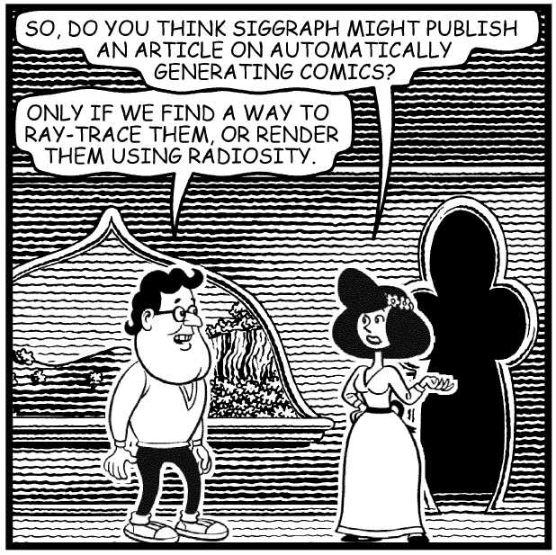
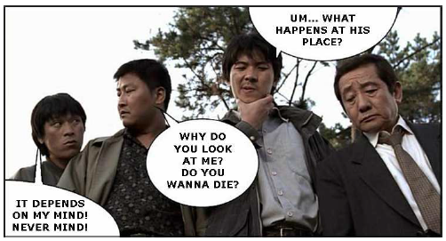
Related Work
Balloon Placement
[Chun et al. 2006]
[Kurlander et al. 1996]

Slide 7
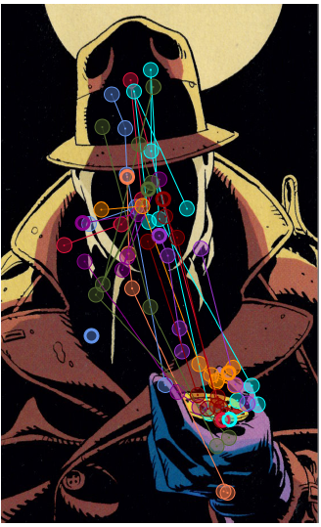
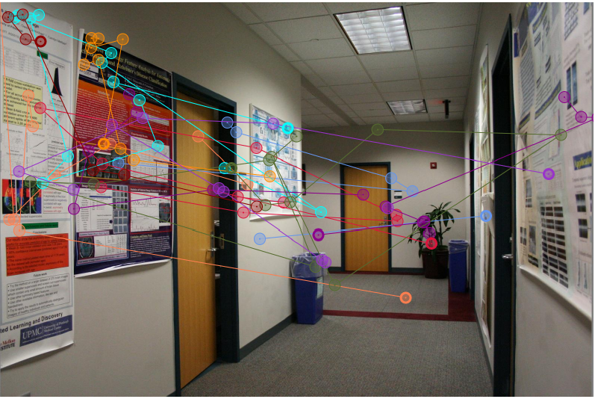
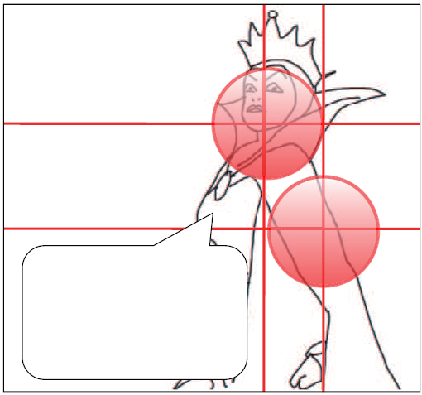
Related Work
Eye-tracking Techniques for Comic Analysis and Creation
[Jain et al. 2012]
[Toyoura et al. 2012]

Slide 8
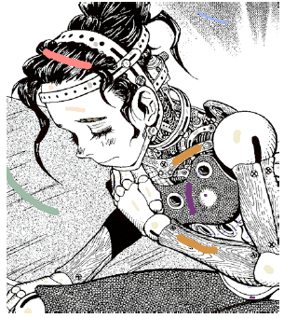

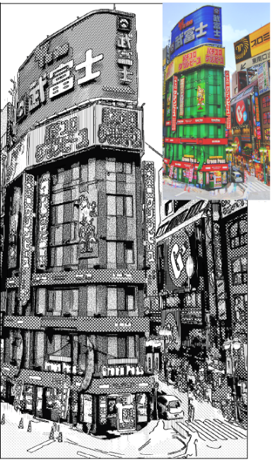
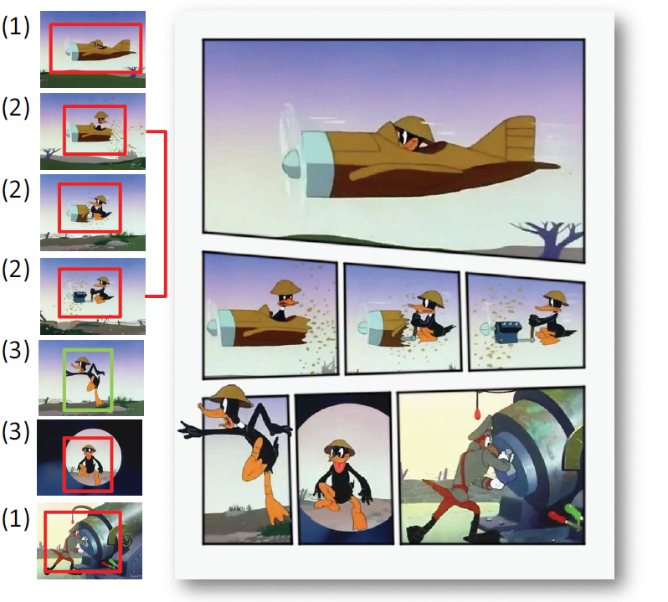
Related Work
Computational Manga
[Qu et al. 2006]
[Cao et al. 2012]
[Qu et al. 2008]

Slide 9
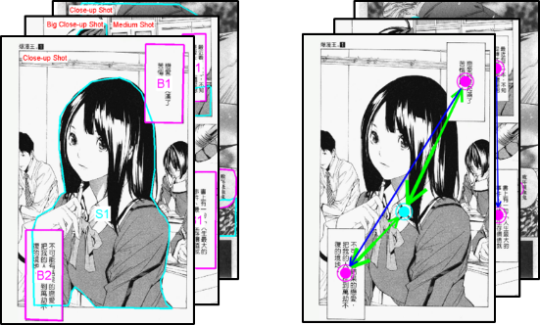

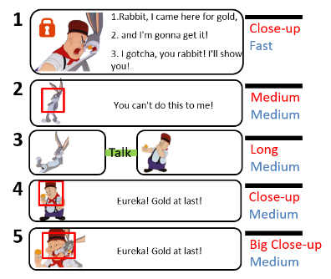
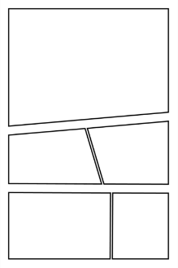



Overview
Data
Learn
Input
Infer
$$G$$
$$C$$
$$A$$
Input Storyboard
Layout
Probabilistic Graphical Model

Slide 10
Probabilistic Graphical Model

Slide 11
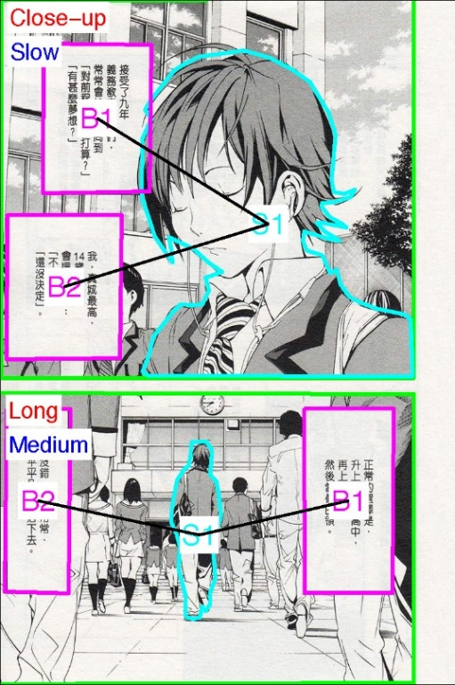
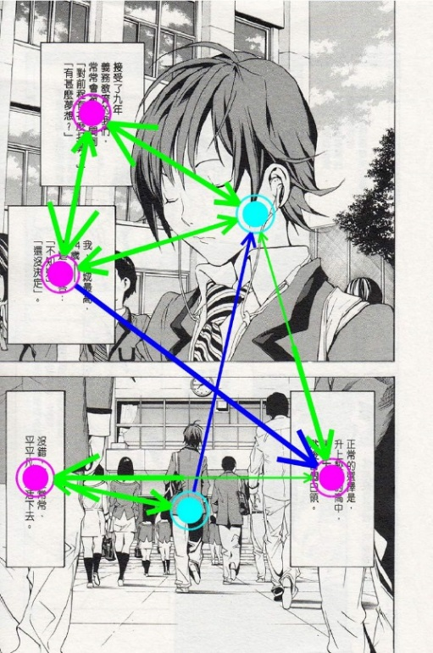
Data Acquisition
80 manga pages from three manga series
[Panel Shape]
[Subject]
[Balloon]
[Shot type]
[Motion state]
Annotation
Eye movements of viewers

Slide 12



Probabilistic Graphical Model
Connects artist’s guiding path, composition and viewer attention in a probabilisitc network
Artist’s Guiding Path
Viewer Attention
$$G$$
$$C$$
$$A$$
Composition
Abstracts artist’s guiding path as a latent variable
Used for composition synthesis

Slide 13
Probabilistic Graphical Model
Panel Properties
Local Composition
in Panel
Subject Placement
Artist’s Guiding Path
Viewer Attention
(eye-gaze path)
Balloon Placement

Slide 14
Probabilistic Graphical Model
Panel Properties
Local Composition
in Panel
Subject Placement
Artist’s Guiding Path
Viewer Attention
(eye-gaze path)
Balloon Placement

Slide 15






Artist’s Guiding Path
$$I$$
$$I(t)$$
$$f$$
$$\text{mean} \text{of} \text{f}\text{(}\text{t}\text{)}$$
$I$:
actual AGP
$f$:
underlying AGP

Slide 16
Probabilistic Graphical Model
Panel Properties
Local Composition
in Panel
Subject Placement
Artist’s Guiding Path
Viewer Attention
(eye-gaze path)
Balloon Placement

Slide 17




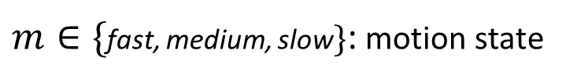
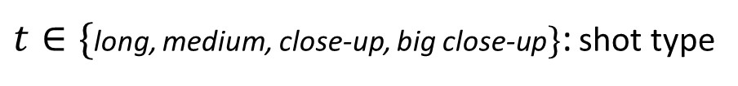




Panel Properties and Local Composition Model
$$P$$
$P=\{g, t, m\}$
$$g, t, m$$
$$r^{L}$$
$$x^{L}$$
$$L$$
$$L=\{x^{L}, r^{L}\}$$
$g$: geometric shape
$t∈\{$long, medium, close-up, big close-up$\}$: shot type
$m∈\{$fast, medium, slow$\}$: motion state

Slide 18
Probabilistic Graphical Model
Panel Properties
Local Composition
in Panel
Subject Placement
Artist’s Guiding Path
Viewer Attention
(eye-gaze path)
Balloon Placement

Slide 19








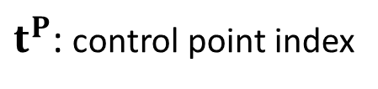


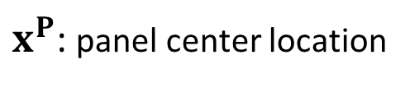
Subject Placement
$$x^{P}$$
$$t^{S}$$
$x^{L}$+$x^{P}$
$$L$$
$$S$$
$$x^{S}$$
$$I(t^{S})$$
$$S=\{x^{S}, r^{S}\}$$
$$r^{S}$$
$$I$$
$x^{P}$: panel center location
$t^{P}$: control point index

Slide 20
Probabilistic Graphical Model
Panel Properties
Local Composition
in Panel
Subject Placement
Artist’s Guiding Path
Viewer Attention
(eye-gaze path)
Balloon Placement

Slide 21








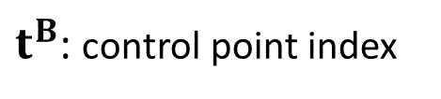



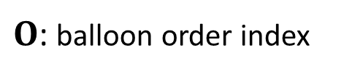
Balloon Placement
$$I(t^{B})$$
$$S$$
$$x^{B}$$
$$r^{B}$$
$$I$$
$$B$$
$$B=\{x^{B}, r^{B}\}$$
$$x^{S}$$
$$r^{S}$$
$$t^{B}$$
$$O$$
$t^{B}$: control point index
$O$: balloon order index

Slide 22
Probabilistic Graphical Model
Panel Properties
Local Composition
in Panel
Subject Placement
Artist’s Guiding Path
Viewer Attention
(eye-gaze path)
Balloon Placement

Slide 23









Viewer Attention
$$S$$
$$U$$
$$x^{B}$$
$$r^{B}$$
$$U$$
$$B$$
$$x^{S}$$
$$r^{S}$$
$U$: viewer attention transition

Slide 24
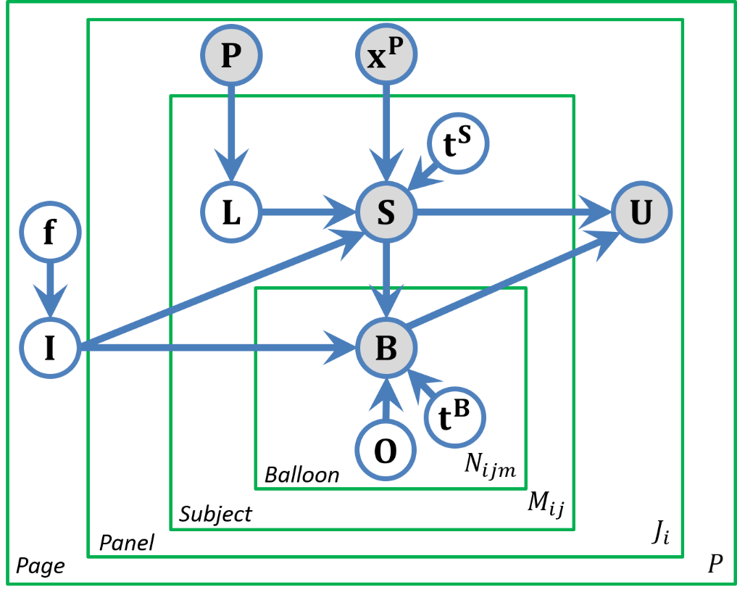
Complete Model

Slide 25
Interactive Composition Synthesis

Slide 26
Interactive Composition Synthesis
Generate a composition, subject to user-specified semantics
Close-up
1.Rabbit, I came here for gold,
2. and I'm gonna get it!
3. I gotcha, you rabbit! I'll show you!
Input:
Talk
Fast
subject & script
shot type &
motion state
inter-subject constraint
Layout Generation + Composition Synthesis

Slide 27
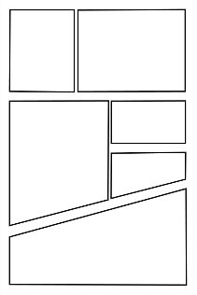
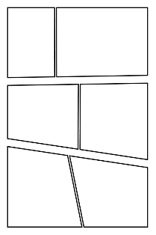
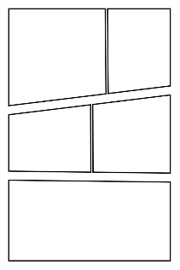
Layout Generation
[# of panels ]
[# of subjects]
[# of balloons]
[shot type]
[motion state]
…
Database of labeled pages

Slide 28
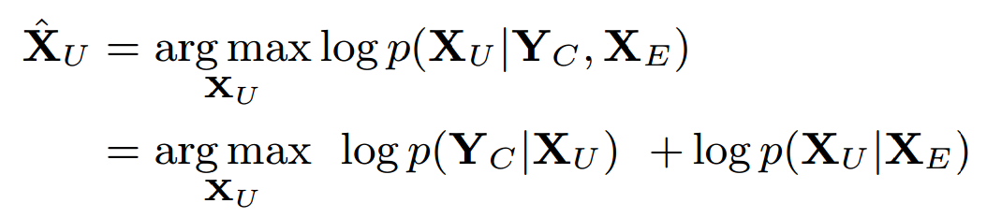



Composition Synthesis
$X_{E}$
Input elements & semantics + Layout
Configurations of elements
Constraints
$$Y_{C}$$
$X_{U}$
A Maximum A Posteriori inference framework
Constraint-based likelihood
Conditional prior

Slide 29
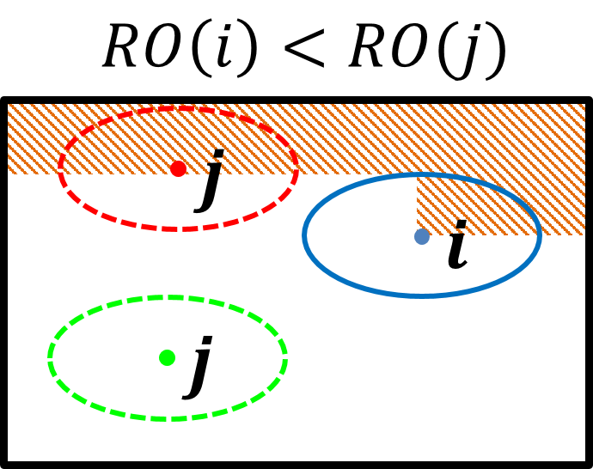
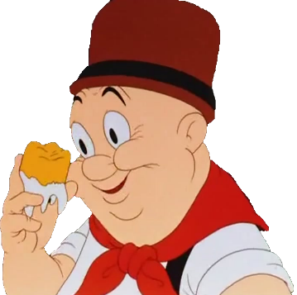
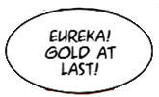
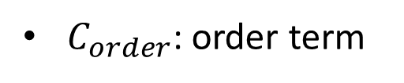
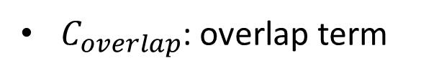
Constraint-based likelihood
$C_{overlap}$: overlap term
$C_{order}$: order term

Slide 30












Constraint-based likelihood
$C_{bound}$: boundary term
$C_{relation }=C_{size}+C_{interact}:$ subject relation term
$$r_{i}$$
$$r_{j}$$
Interaction $e=$ “Talk”
$$v_{ij}$$
shot $t=$ “medium”
$∥r_{i}−r_{j}$ $∥$
$∥v_{ij}−v_{e,t}∥, v_{e,t}∼p_{e,t}(v)$

Slide 31
Results and Evaluation
Notes:
Finally, I will show results and evaluation.

Slide 32
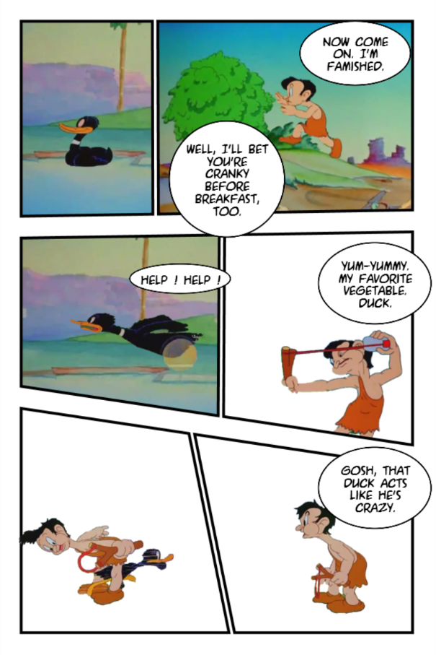
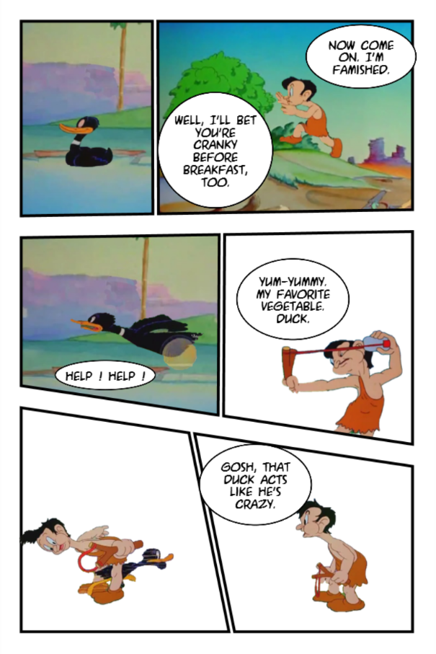
Comparison to Heuristic Method for Balloon Placement
Heuristic [Chun et al. 2006]
Our approach

Slide 33
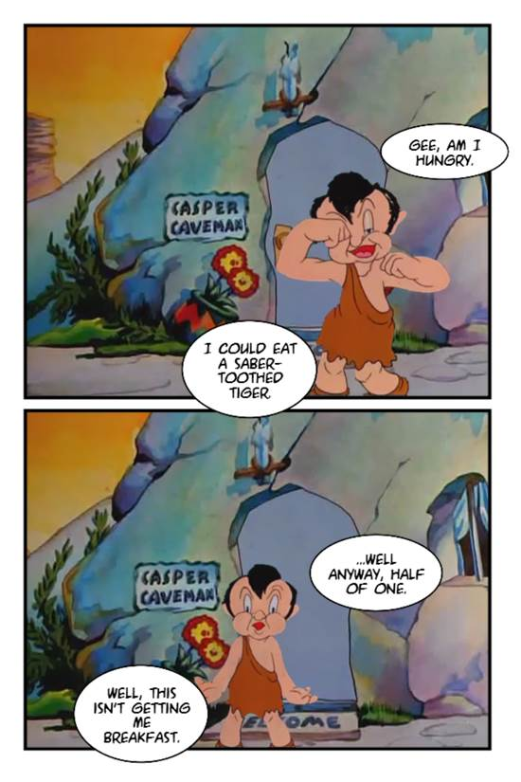
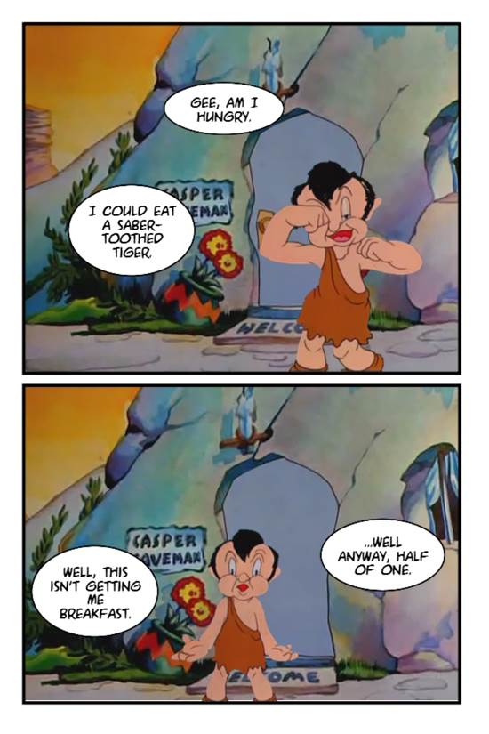
Comparison to Heuristic Method for Balloon Placement
Heuristic [Chun et al. 2006]
Our approach

Slide 34
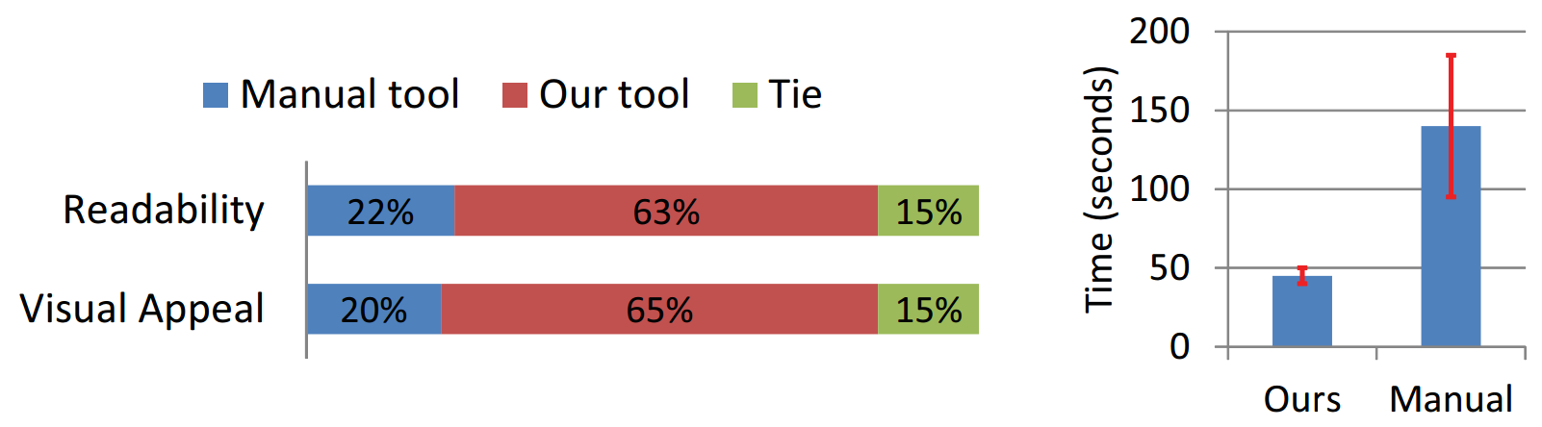
Comparison to Manual Method
User study: How well does our approach facilitate manga composition, as compared to existing manual tool?
Participant preference voting
Time for one composition

Slide 35
Eye-tracking Experiment and Analysis
Is our approach effective in directing viewer attention, as compared with the alternatives?
To measure fixation consistency across different viewers
Similarity metrics:
    Inlier percent
    Root Mean Squared Distance (RMSD)

Slide 36
Eye-tracking Experiment and Analysis
Inlier percent
Viewer B
Viewer A
Saliency Map
Classification
Inliers

Slide 37
Eye-tracking Experiment and Analysis
RMSD
RMSD
,
Viewer A
Viewer B

Slide 38
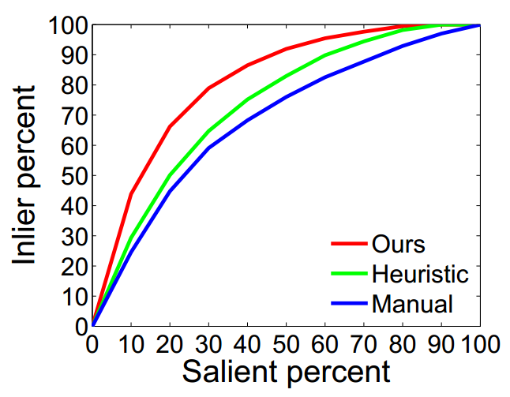
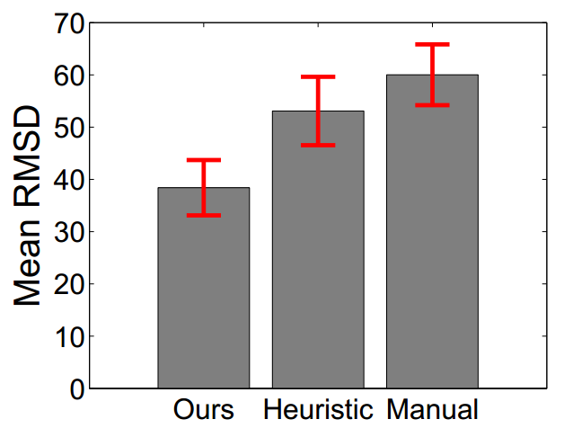
Eye-tracking Experiment and Analysis

Slide 39
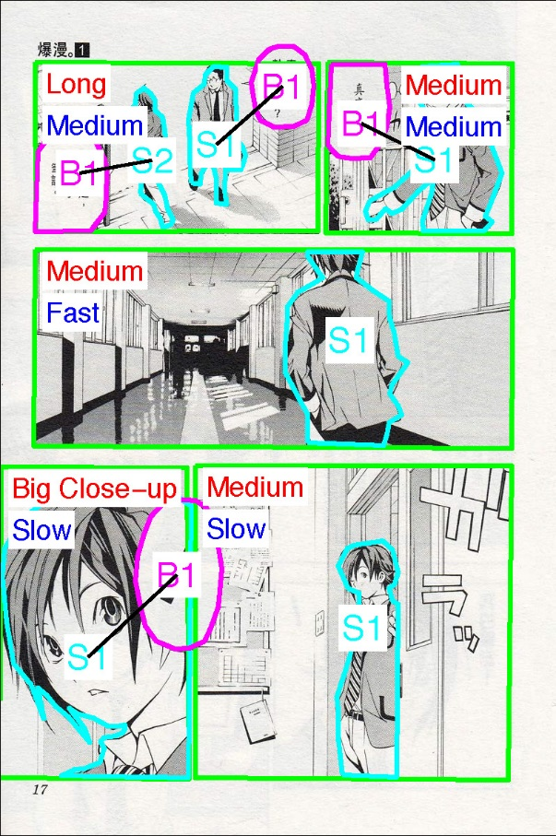
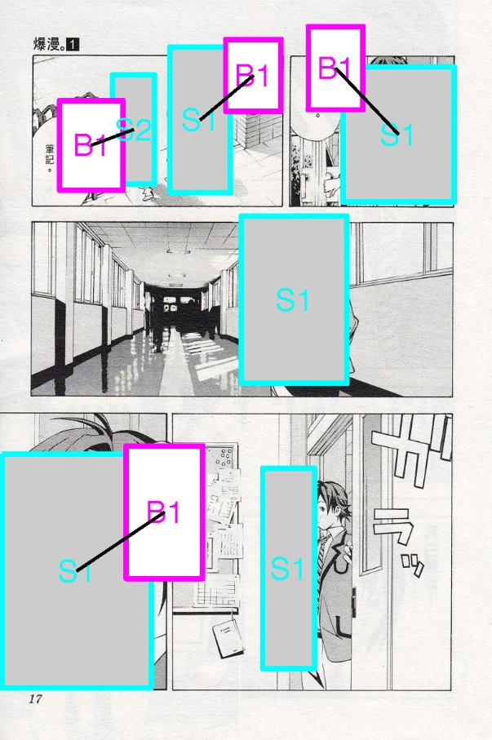
Comparison to Existing Manga Pages
Original
Synthesized
© Tsugumi Ohba, Takeshi Obata / Shueisha Inc.

Slide 40
Summary
A novel model for representing dependency among the artist’s guiding path, composition and viewer attention
A novel approach for joint composition of subjects and balloons
Enable easy and quick creation of attention-directing compositions

Slide 41
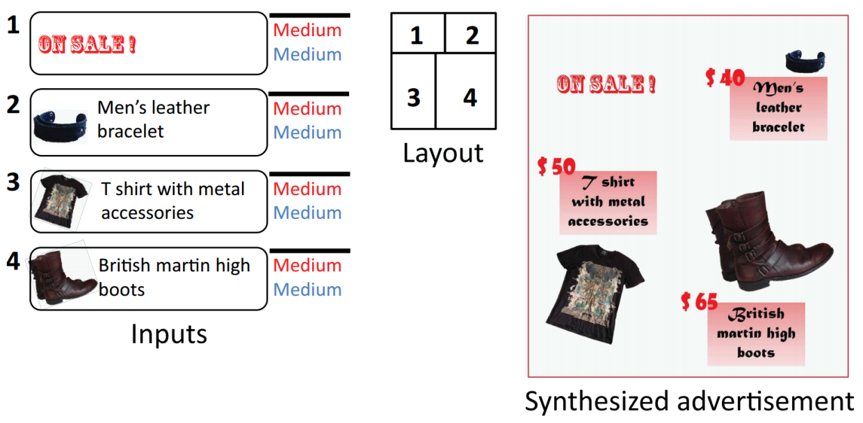
Limitations & Future Work
Consider visual appearance of manga elements
Extend to other graphic design tasks
Understand readers’ behaviors

Slide 42
Thanks

